Slide 1
Beer and STATEs
by: Joshua Yi

Slide 2
introduction
Analysis on the U.S. craft beers and breweries dataset
Data provided to us by our clients the CEO and CFO of Budweiser.
What will be covered:
Breweries by state
Analysis on beer content
Correlation between alcohol and ibu content
Conclusion

Slide 3
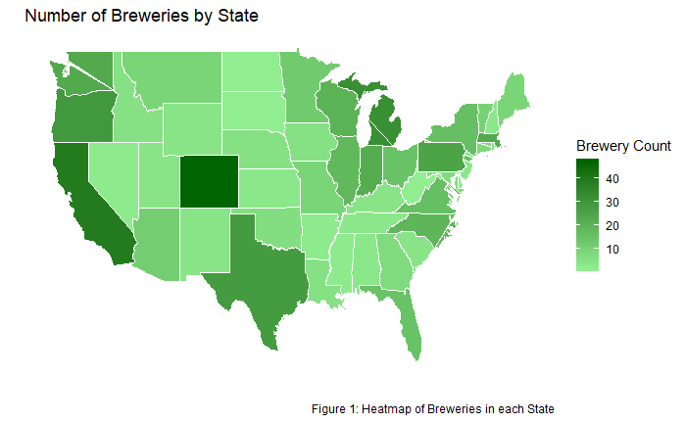
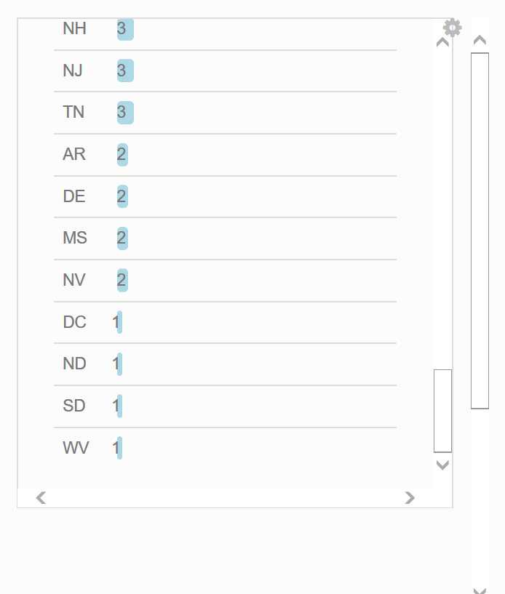
Breweries by state

Slide 4
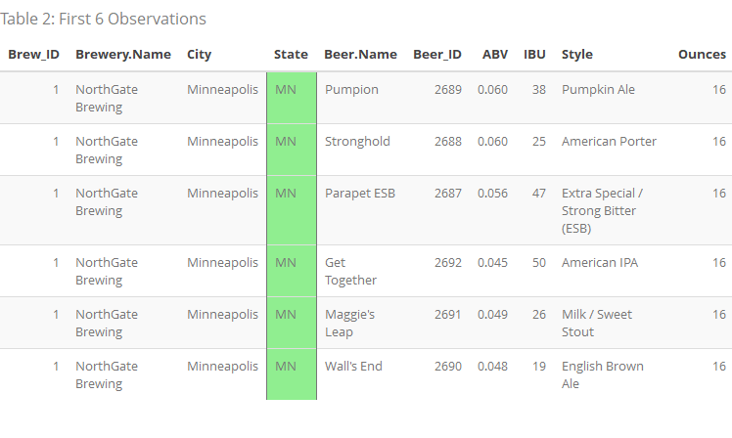
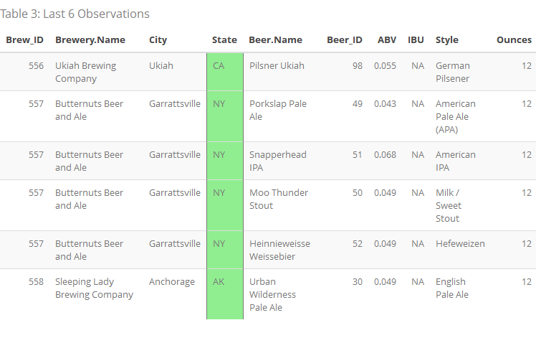
observations
Merging of the US Craft Beers and Breweries dataset
Q/A check
List of Breweries with Beer Content

Slide 5
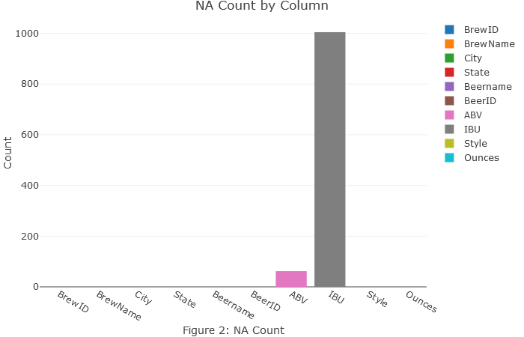
Missing Data
62 NA’s ABV
1005 NA’s IBU

Slide 6
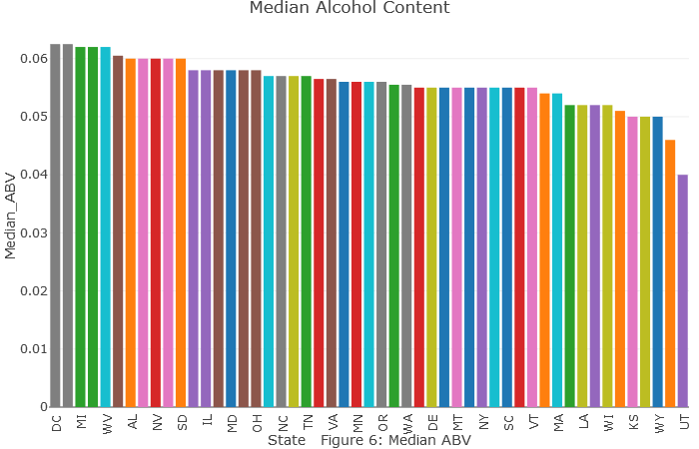
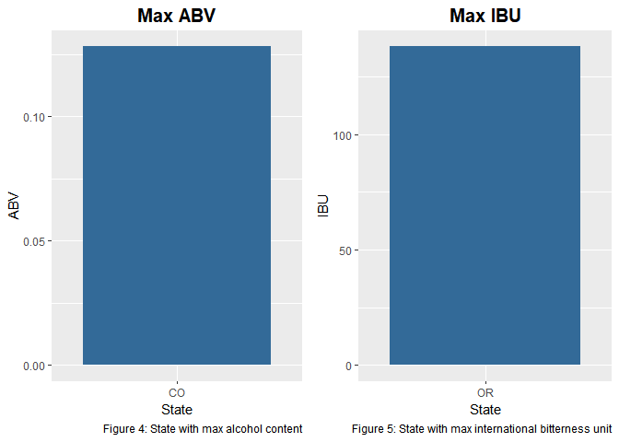
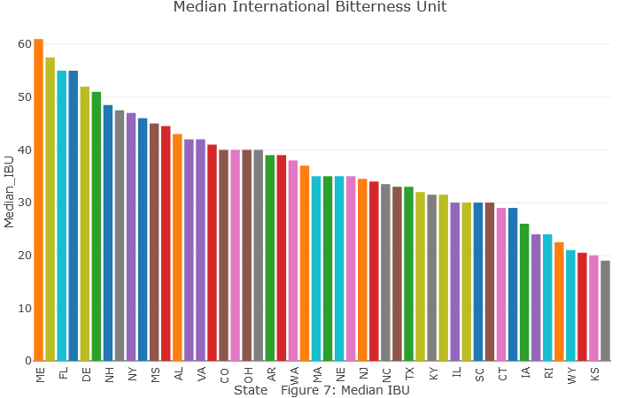
Summary Analysis

Slide 7
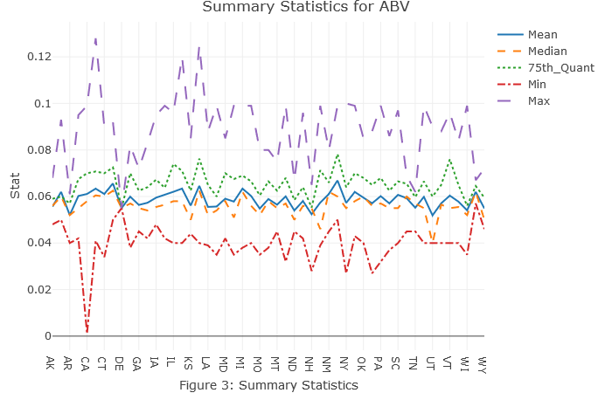
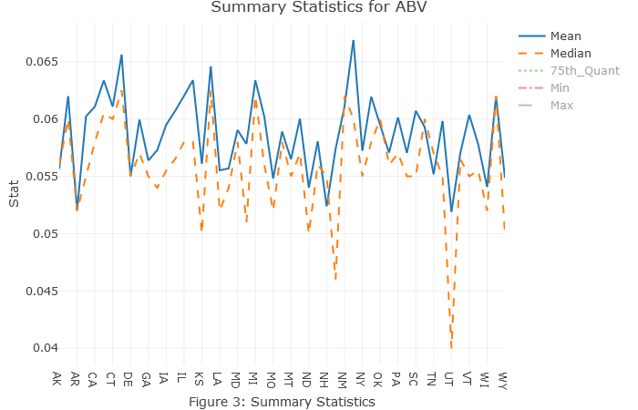
Summary Continued…
Mean, Median, 75th quantile, min and max
Right-skewed

Slide 8
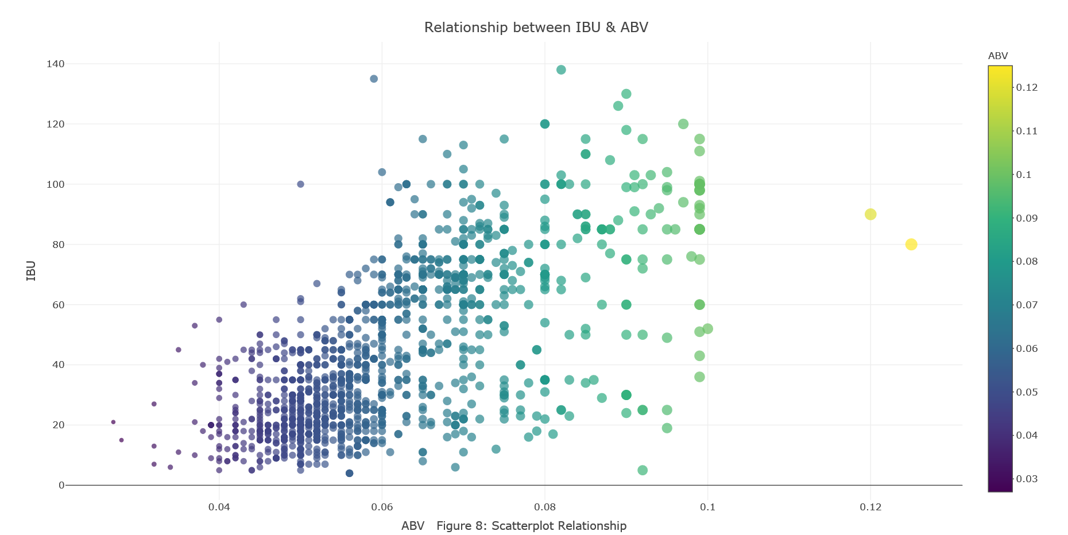
Relationships between abv & ibu
As ABV goes up, IBU tends to go up
outliers
Clustering

Slide 9
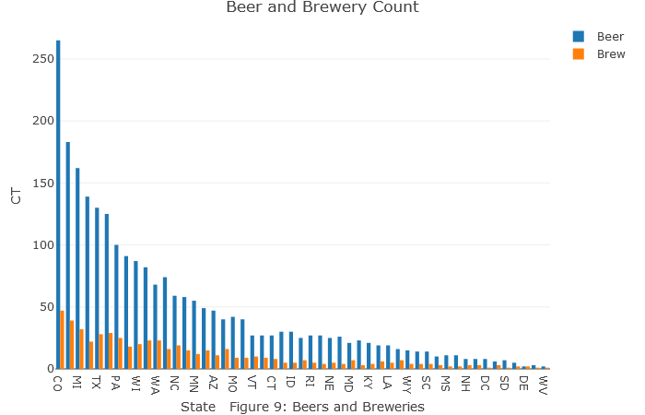
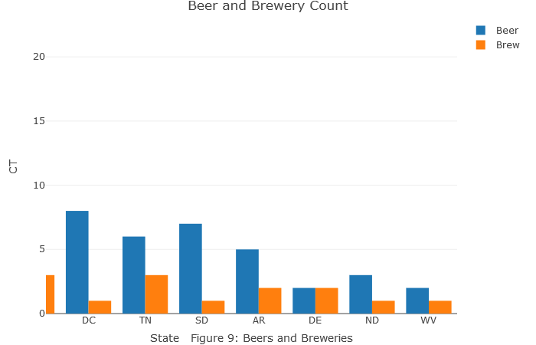
recommendation
Produce beer content around the cluster
Consumer wants
Hit areas with low brewery and beer type count

Slide 10
YouTube Presentation Link
https://www.youtube.com/watch?v=wU10V0931FQ

